Slide 1
Arrays declared at runtime are not stored in the heap. Instead, they are stored as part of the text and data of Binary. Arrays are stored continuously.

Slide 2
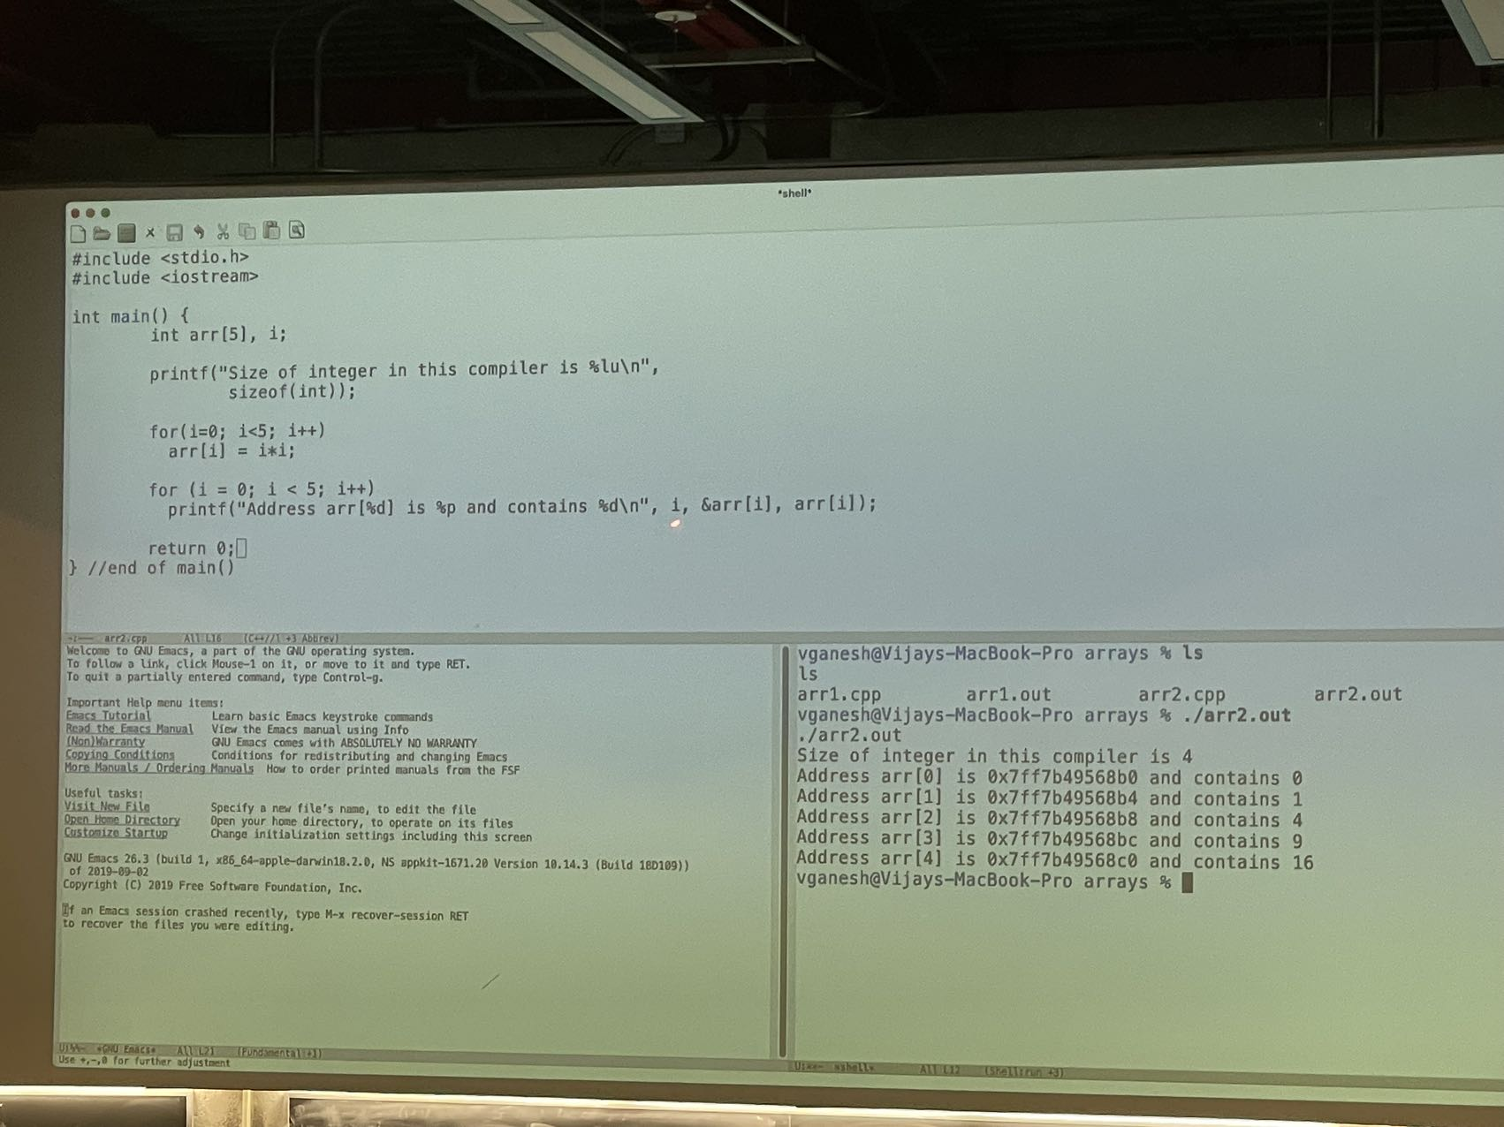
Notes:
Compiler knows how much memory to allocate at compile time for an array.
Continuous layout of data.
Access of any index can be done in O(1) time.
For sort(): Output must be a permutation of input.
Time complexity means the time takes for the program to run in terms of the size of the input.
Arrays are statically allocated.
Lists, Trees, Graphs, etc., are dynamically allocated.

Slide 3
Notes:
Input of Append function: Head of a list and the Data.
Output of Append function: Original List → Data → Null

Slide 4
A Tour of C++: A Compiler and Systems Perspective Vijay Ganesh University of Waterloo Co-Director, Waterloo.ai

Slide 5
Context and Motivation

Slide 6
How is this introduction to C++ different from others?
There are many excellent tutorials on C++ (and other programming languages) on the internet. They usually emphasize the various features of the programming language being taught
By contrast, in this course the emphasis is on system building rather than learning esoteric features of C++. We will learn those features of C++ that we need to build a SAT solver.
We also learn the correspondence between the feature or abstraction of the C++ language, and the corresponding system elements, i.e., the mapping, from programming language abstractions to underlying aspects of the system, performed by the compiler
My approach is designed to give you depth, rather than breadth

Slide 7
What is Computation?
Any computational model should be able to simulate another computational model.
There are many models and definitions of computation, developed over the years by a variety of scientists that range from analog to digital, from purely functional to imperative, etc.
The dominant model of computation today is that developed by Turing in 1936 called the Turing machine, and its more modern cousins whose foundations were laid by Turing, Van Neumann, and others
Turing not only invented one of the first digital computers, but also laid the foundation of computability theory where we study different models of computation, as well as Artificial Intelligence (AI)
All modern digital computers have the following features in common:
Programmability
Universality, i.e., can simulate or run any other known form of computation
Basic modular arithmetic instructions
Instructions to read from/write to a programmable memory
Jump instructions to implement loops/recursion and control-flow
Hardware to interpret and execute the above instructions

Slide 8
What is an Algorithm? What is a Program?
An Algorithm is a finite sequence of instructions (with respect to a given computational model, e.g., Turing machines), that takes an input bit string, performs a computation, and may produce an output bit string
The term program and algorithm are often used interchangeably. However, there is a subtle difference. Programs constitute a sub-category of algorithms written in specific programming language with a fixed memory and hardware model, while algorithms are often expressed in pseudo-code that has the most basic instructions necessary for computation, e.g., basic arithmetic, memory operation and jump. (Pseudo code is not necessarily tied to a specific language)
Put differently, a correct program should at the minimum be compilable using an appropriate compiler or interpretable using an appropriate interpreter. On the other hand, we don’t expect an algorithm, presented in pseudo-code, to be compilable or interpretable

Slide 9
Programming Languages and Abstractions
The most basic abstraction of a modern digital computer is via its assembly language, which consists of
Basic modular arithmetic instructions, instructions to read from/write to memory, jump instructions to implement loops/recursion and control-flow
A memory model
Turing-complete: we say two programming languages A and B are Turing-complete if programs written in A can be equivalently written in/converted to some program in B and vice-versa, and further can be equivalently expressed as a Turing machine.
Most modern programming languages are Turing-complete.
The primary purpose of higher-level languages is to make programmer’s more productive and the task of programming easier
Today’s languages provide powerful abstractions and error-detection via
A memory model (dynamic and static allocation), that exposes only the bare minimum to the programmer. The programmer, in most cases, doesn’t have to worry about how memory is laid out, how the instructions are interpreted and executed etc.
Powerful data structure and concurrency libraries that encourages code reuse
Type systems that catch many common errors, and error-reporting
Concepts such as object-orientation, solver-based type systems, garbage collection,…
Powerful IDEs that combine compilation, linking, code completion, automated test generation, integrated revision systems etc.
Java, Python, C++ and Assembly are all Turing-Complete languages.

Slide 10
Types of High-level Programming Languages
Imperative
Control-flow of the program is specified explicitly
Allows for program state to be changed, e.g., via assignments
Programmer specifies the WHAT and the HOW
Examples include C/C++, Java, Python etc.
Declarative
Programmer only specifies WHAT, and the system figures out the HOW
Examples include SQL, HTML,…
Functional
Code is specified as functions, that don’t have side-effects, no assignments
Examples include Haskell, Curry,…
Logic-based
Code is specified in terms of mathematical formulas, e.g., Datalog
Hybrid
Many languages are hybrid, i.e., have features of both declarative and imperative languages. Examples include Scala,…

Slide 11
Where does object-orientation fit in?
The concept of object orientation is orthogonal to imperative vs. declarative
A language can be imperative and object-oriented, or declarative and object-oriented
Object-orientation refers to a set of properties of a programming language that has to do with code and data reuse is enabled, and the rules regarding how data is allowed to be accessed and manipulated by code

Slide 12
What about a language’s type system?
Type systems are a feature of most modern programming languages that enable code understanding and error detection during compilation
What is a type?
A tag or label, and a set of associated typing rules, that tell the compiler how a piece of data (with a particular type) can be manipulated at run time
Static vs. Dynamic Typing
Static: types are supplied by the programmer as part of the code. Typically, types are fixed and defined as part of the programming language. Languages such as C++ support static typing
Dynamic: types are inferred by an interpreter of the language, at run time, based on the operations performed on a piece of data. Examples of languages that support dynamic typing includes Python
Strong vs. Weak type systems
It is difficult to classify languages as completely strongly-typed vis weakly-typed. Languages fall into a range when viewed from the strength of their type systems.
Strongly typed languages are ones which have well-defined types and type conversions with resulting unsafe operations are discouraged. Java is an example of a strongly-typed language

Slide 13
Understanding C++
Compilation, understanding run time vs. compile time
Structure of binaries
Syntax and Semantics
Strong typing
Object-oriented, i.e., what are classes, objects, inheritance etc.
Templates (Standard Template Library)
Pointers
Recursion
Basic memory management

Slide 14
Understanding C++: An Overview of Compilation Run time vs. Compile time

Slide 15
What is a compiler?
A compiler is a computer program that takes as input a program in a high-level language (e.g., C++) and converts it into equivalent binary code
Optimization: We expect compilers to produce optimized output code (e.g., optimized for time efficiency, memory usage, power consumption, etc.)
Type checking: Checks if the operations performed on data are permitted by the type system of the programming language (implemented as part of the compiler)
Linking libraries (static vs. dynamic), error reporting, automatic parallelization,…

Slide 16
The Structure (Phases) of a typical Compiler
Semantic Analysis (Type Checking,…)
Input Program
Lexical Analyzer
Tokens
Parser
AST
Three
Address
Format
Intermediate Representation (IR)
Output
Program
Code
Generation
Code Optimizations

Slide 17
Lexical Analyzer
A lexical analyzer is a computer program that takes as input a string, and outputs the following:
A sequence of tokens. A token denotes a category of string. Tokenization of strings is usually represented using “regular expressions”.
If the input string does not adhere to/belongs to the regular expression of a lexical analyzer, then the analyzer typically outputs an error message.

Slide 18
Lexical Analysis
First step: recognize words.
Smallest unit above letters
This is a sentence.

Slide 19
And More Lexical Analysis
Lexical analyzer divides program text into “words” or “tokens”
If x == y then z = 1; else z = 2;
Units:
Keywords
Variables
Operators
Constants
Punctuations
White spaces

Slide 20
Parsing
Once words are understood, the next step is to understand sentence or grammatical structure
Parsing = Diagramming Sentences
The diagram is a tree
A parser P is a computer program that takes as input a string S, and does the following:
Checks if the input string S belongs to the Context Free Grammar (CFG) implemented as part of the parser P. If not, then the parser P outputs an error
If S belongs to the CFG of P, then P outputs an Abstract Syntax Tree (AST) that “diagrammatically captures” S
Context Free Grammars are finite set of recursive rules (objects) that characterize possibly infinite set of sentences. Every programming language has a CFG that characterizes syntactically correct programs in that language.

Slide 21
Diagramming a Sentence
This
line
is
a
long
sentence
article
noun
verb
article
adjective
noun
subject
object
sentence

Slide 22
Parsing Programs
Parsing program expressions is similar
Consider:
If x == y then z = 1; else z = 2;
Diagrammed:
x
==
y
z
1
z
2
relation
assign
assign
predicate
then-stmt
else-stmt
if-then-else-stmt

Slide 23
The Structure (Phases) of a Compiler
Semantic Analysis (Type Checking,…)
Input Program
Lexical Analyzer
Tokens
Parser
AST
Three
Address
Format
Intermediate Representation (IR)
Output
Program
Code
Generation
Code Optimizations

Slide 24
Semantic Analysis
Once sentence structure is understood, we can try to understand “meaning”
However, understanding meaning of programs automatically is too hard
Compilers perform limited analysis to catch inconsistencies or certain kinds of errors, e.g., type errors are caught via type checking

Slide 25
Semantic Analysis in English
Example:
I saw a man on a hill with a telescope
It seems like a simple statement, until you begin to unpack the many alternate meanings:
There’s a man on a hill, and I’m watching him with my telescope.
There’s a man on a hill, I see him, and he has a telescope.
There’s a man, and he’s on a hill that also has a telescope on it.
I’m on a hill, and I saw a man using a telescope.
Further, the word ‘saw’ has multiple meanings.

Slide 26
Semantic Analysis in English
Example:
Jack said Jack left his assignment at home?
How many Jacks are there?
Is Jack referring to himself in third person?
Which one left the assignment?

Slide 27
Semantic Analysis in Programming
Programming languages define strict rules to avoid such ambiguities, e.g., variable binding or scoping rules
This C++ code prints “4”; the inner definition is used
{
int Jack = 3;
{
int Jack = 4;
cout << Jack;
}
}

Slide 28
More Semantic Analysis
Compilers perform many semantic checks besides variable bindings, e.g., type-checking
Example:
Jack left her homework at home.
A “type mismatch” between her and Jack; we know they are different people
Presumably Jack is male

Slide 29
Type Checking
The type checker takes as input the abstract syntax tree (AST) corresponding to a program and checks the following:
Are the input to functions, at call sites, of the appropriate type?
Are operations on variables consistent with the type of those variables?
Are type conversions being performed properly?
In certain programming languages, type systems can check whether pointers being dereferenced are NULL?
Are subtyping relations, as defined by inheritance or polymorphism, being respected?
Are function and class templates being used properly?
Etc.
If the answer is NO to any of the above questions, then a type system will throw a type error with an appropriate error message

Slide 30
The Structure (Phases) of a Compiler
Semantic Analysis (Type Checking,…)
Input Program
Lexical Analyzer
Tokens
Parser
AST
Three
Address
Format
Intermediate Representation (IR)
Output
Program
Code
Generation
Code Optimizations

Slide 31
Code Optimization
No strong counterpart in English, but akin to editing
Automatically modify programs so that they
Run faster
Use less memory
Use less power
In general, optimize for some resource

Slide 32
Optimization Example
X = Y * 0 is the same as X = 0
Another example is dead-code elimination
Register allocation, cache-aware optimizations
Use of special-purpose instructions, e.g., specific to graphics or FFT

Slide 33
The Structure (Phases) of a Compiler
Semantic Analysis (Type Checking,…)
Input Program
Lexical Analyzer
Tokens
Parser
AST
Three
Address
Format
Intermediate Representation (IR)
Output
Program
Code
Generation
Code Optimizations

Slide 34
Code Generation
Code generation is defined as a translation of the program into another language
Typically produces binary code
Special-purpose instruction set
Hardware retargetability

Slide 35
Intermediate Languages
Many compilers perform translations between successive intermediate forms
All but first and last are intermediate languages internal to the compiler
Typically, there is only one IL (aka IR)
ILs are generally ordered in descending level of abstraction
Highest is source
Lowest is assembly

Slide 36
Intermediate Languages (Cont.)
ILs are useful because lower levels expose features hidden by higher levels
registers
memory layout
Enable new optimizations that are otherwise hidden
But lower levels obscure high-level meaning
Designing IL that balances exposing low-level hardware features while maintaining high-level structure is very hard

Slide 37
Compile time vs. Run time
When we use the term “compile time”, we are referring to what happens to a program as a compiler is processing it. For example,
a type checker may flag certain errors in a program at “compile time”.
A syntax error may be flagged by the lexer or parser (different from a type error).
A link error may be flagger by the linker
When we use the term “run time”, we are referring the behavior of the program during its execution (via an interpreter or directly on the hardware). For example,
A dynamic type system might compute a new type
An out-of-memory exception may be thrown
A null pointer may be dereferenced, causing a core dump
Or, the program may behave as expected

Slide 38
Understanding C++: The Pre-processor (#include <…>)

Slide 39
The C++ Preprocessor
C++ is based on C, which was written in the early 1970s
Any command starting with a # in the first column is not a C/C++ statement, but rather a preprocessor statement
The preprocessor performs very basic text-based (or lexical) substitutions
The output is sent to the compiler

Slide 40
The C++ Preprocessor
The sequence is:
file (filename.cpp) → preprocessor → compiler (g++)
Note, this is done automatically by the compiler: no additional steps are necessary
At the top of any C++ program, you will see one or more directives starting with a #, e.g.,
#include <iostream>

Slide 41
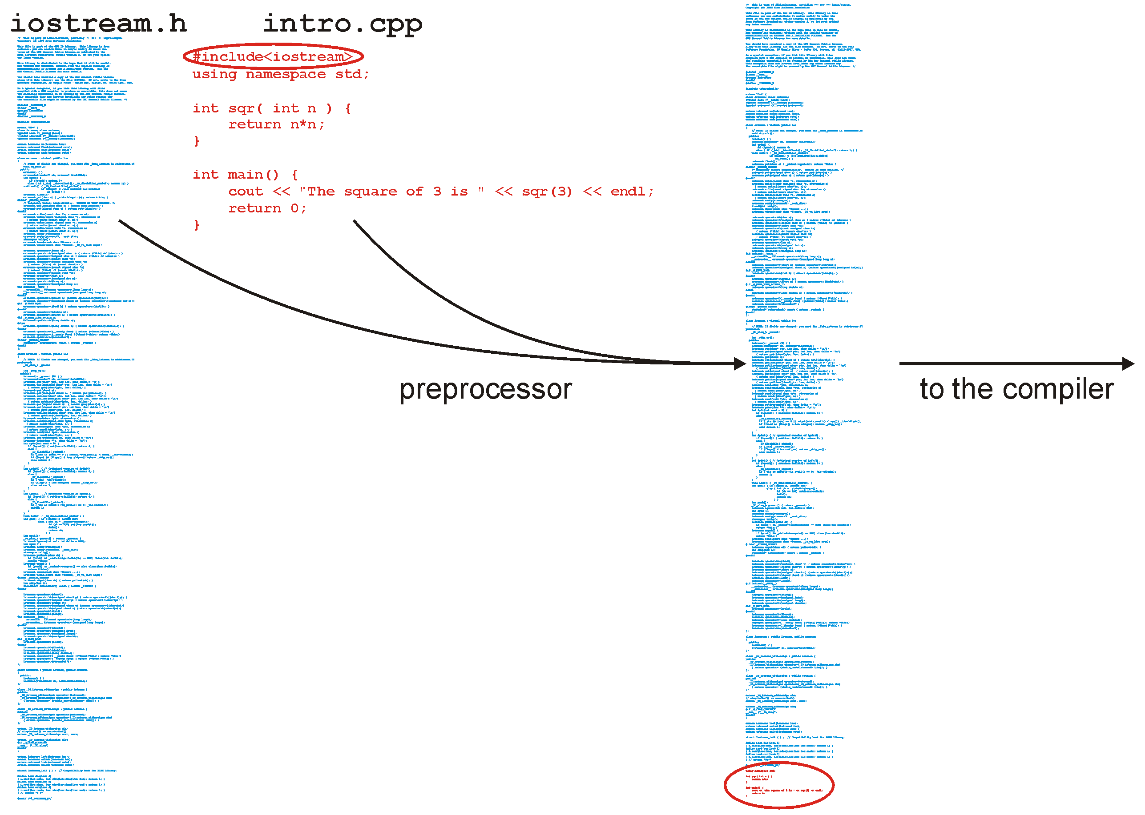
The C++ Preprocessor

Slide 42
Libraries
You will write your code in a file such as Single_list.h where you will implement a data structure
This file will be included in our tester file Single_list_tester.h with a statement such as:
#include "Single_list.h"
The file Single_list_int_driver.cpp then includes the tester file:
#include "Single_list_tester.h"

Slide 43
Libraries
You will note the difference:
#include <iostream>
#include "Single_list.h"
The first looks for a file iostream.h which is shipped with the compiler (the standard library)
The second looks in the current directory
Notes:
43

Slide 44
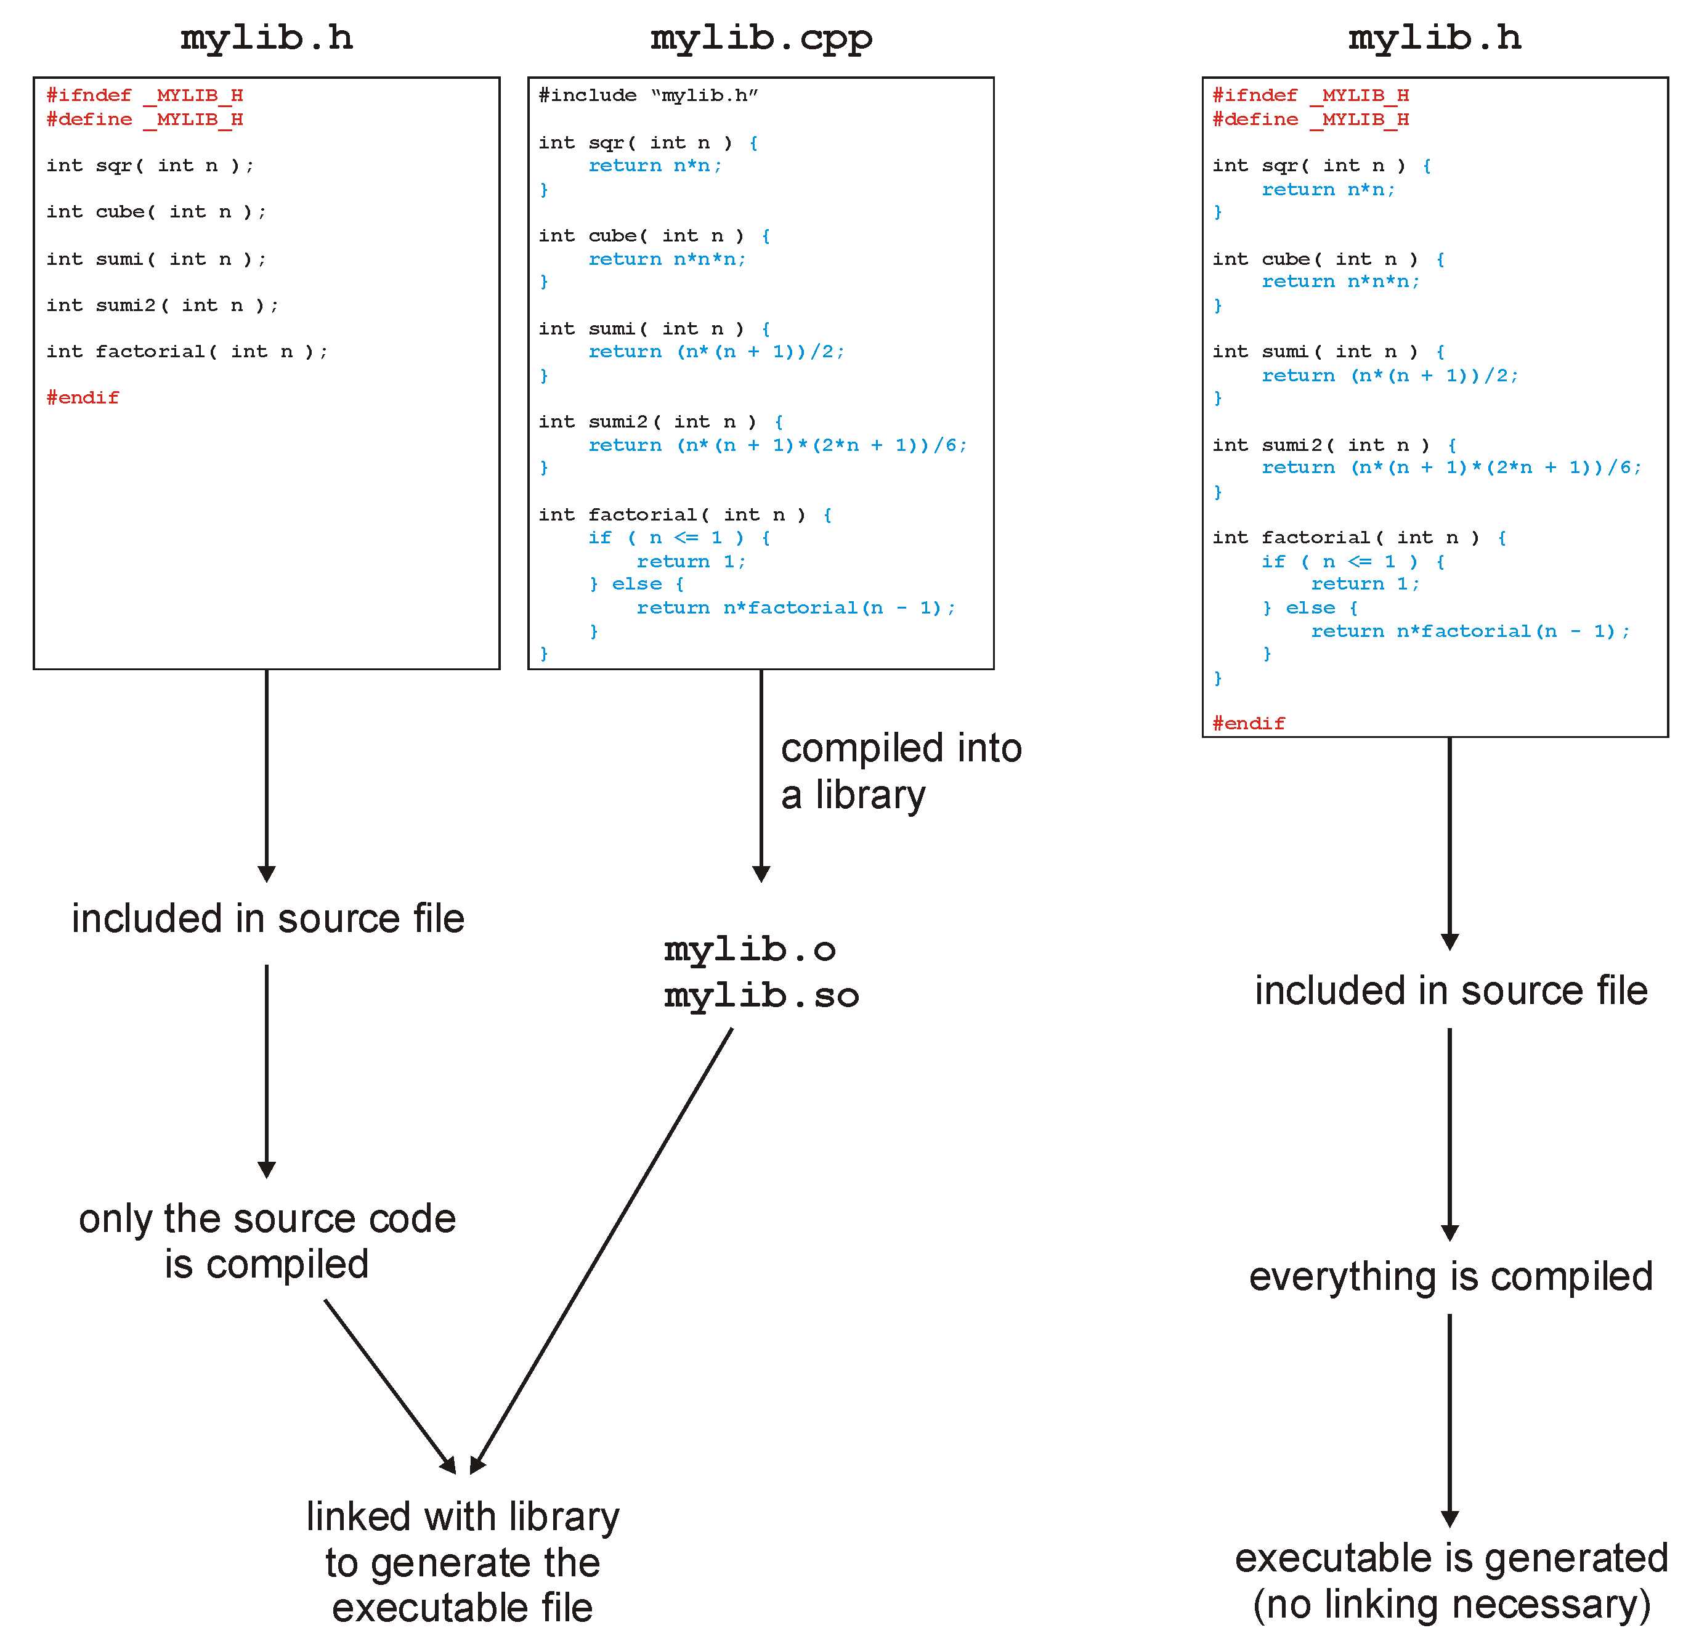
The C++ Preprocessor

Slide 45
The C++ Preprocessor
With all these includes, it is always necessary to avoid the same file being included twice, otherwise you have duplicate definitions
Using a pragma directive
#pragma once
template <typename Type>
class Single_list {
///...
};
Notes:
45

Slide 46
The C++ Preprocessor
With all these includes, it is always necessary to avoid the same file being included twice, otherwise you have duplicate definitions
Or (using an old style) with guard statements:
#ifndef SINGLE_LIST_H
#define SINGLE_LIST_H
template <typename Type>
class Single_list {
///...
};
#endif
Notes:
46

Slide 47
The C++ Preprocessor
This class definition contains only the signatures (or prototypes) of the operations
the interface, function declaration, class declaration, etc.
The actual member function definitions may be defined elsewhere, either in:
The same file, or
Another file which is compiled into an object file
We will use the first method

Slide 48
The File as the Unit of Compilation
In C/C++, the file is the base unit of compilation:
Any .cpp file may be compiled into object code
Only files containing an int main() function can be compiled into an executable
The signature of main is:
int main (int argc, char* argv[]) {
// does some stuff
return 0;
}
The operating system is expecting a return value
Usually 0

Slide 49
The File as the Unit of Compilation
This file (example.cpp) contains two functions
#include<iostream>
using namespace std;
int sqr( int n ) { // Function declaration and definition
return n*n;
}
int main() {
cout << "The square of 3 is " << sqr(3) << endl;
return 0;
}

Slide 50
The File as the Unit of Compilation
To compile this file, we execute on the command line:
{ecelinux:1} g++ example.cpp -o example
{ecelinux:2} ls
example example.cpp
{ecelinux:3} ./example
The square of 3 is 9
{ecelinux:4}

Slide 51
The File as the Unit of Compilation
This is an alternate form:
#include<iostream>
using namespace std;
int sqr( int ); // Function declaration
int main() {
cout << "The square of 3 is " << sqr(3) << endl;
return 0;
}
int sqr( int n ) { // Function definition
return n*n; // The definition can be in another file
}

Slide 52
Understanding C++: Code Execution, Linux Process, and Structure of Binaries

Slide 53
What Happens During Program Execution?
Data references: Memory access on load/store instructions
Registers
Program Counter (PC)
Stack Pointer (SP)
Execution sequence
Fetch instruction at PC
Decode
Execute (possibly using registers)
Write results to registers/memory
PC ← Next(PC)
Repeat
Memory
ALU
Registers
Decode
PC
Next
E.g., function calls, return, branches, etc.
Instruction references:
Memory access on every instruction

Slide 54
Memory Hierarchy
At an abstract level, most computers today use the following memory model:
Registers: At the lowest level (closest to the CPU) are the registers. It takes CPU one clock cycle to access the data in registers
L1 cache: At a level above registers are the L1 caches. It takes the CPU around 5 clock cycles to access the data in L1 cache.
L2 cache: Beyond L1, we may have L2 and L3 caches. It can take the CPU 10 clock cycles to access the data in these caches
RAM: Beyond caches, most systems have RAM. It can take the CPU 100’s of clock cycles to access the RAM
Hard disk and backup tape: At the highest level, we have hard disks. These are the slowest, and hence the most expensive, layer of a typical memory system. It can take CPUs 100,000 clock cycles to access hard disks and backup tapes.
Why use a memory hierarchy?
If a system uses appropriate algorithms to access data, evict data (least recently used or LRU), and maintain consistency of data across the memory hierarchy, then it can significantly speedup computation
The closer it is to the CPU, the smaller its size.

Slide 55
Linux Binaries
A Linux binary has a specific format called ELF (Executable and Linkable format): https://www.science.unitn.it/~fiorella/guidelinux/tlk/node62.html
An ELF binary header – that contains some meta-data about the program
Program header table – this tells the OS how to create a memory image of this binary (i.e., the process)
.text section – where the code is stored
.data section – where the global variable data is stored (recall that this info is known at compile time)
Section header table – points to where all the above sections are stored
Global Data structures and global variables.

Slide 56
A Process
A running algorithm is often referred to as a process
When a program is invoked (on the command line or by clicking on an icon etc.), the
operating system initiates the following:
It creates a process, assigns it a process ID, and stores some meta-data to keep track of the process (open file handles, used memory blocks, etc.)
Control is handed over the main() function by updating the Program Counter (PC)
The CPU starts executing code pointed to by the PC
Meta Data is some information about the process.

Slide 57
Linux process memory layout at run time
0xC0000000
user stack
%esp
shared libraries
Pointers that point to shared memories in the system.
0x40000000
brk
Code (text segment)
and init (data segment)
and uninit (bss segment) global data is stored here
run time heap
Loaded from exec
0x08048000
unused
0

Slide 58
Understanding C++: Syntax and Semantics
Important Language Features

Slide 59
Introduction to C++
Basic syntax – borrowed from C
Key features –
Variables – store data and pointers
A rich type and qualifier system
Functions – enable code reuse,
Recursion and recursive function calls
Function declaration vs. definition (why do we need this?)
Control-flow via if-then-else, case-switch
Iteration via for/while/do-while loops
Pointers (why do we need pointers?)
Objects and Classes
Class declaration vs. definition (why do we need this?)
Memory allocation via new, memory management, garbage collection
Polymorphism of various kinds
Class and Function Templates
Namespaces and scoping rules
The syntax of programming languages are rules, and they are enforced by parsers.
Semantics gives meaning to various parts of the program.

Slide 60
Control Statements
All control statements are similar to typical programming languages
if ( statement ) {
// ...
} else if ( statement ) {
// ... while ( statement ) {
} else { // ...
// ... }
}
for ( int i = 0; i < N; ++i ) {
// ...
do { }
// ...
} while ( statement );

Slide 61
Operators
Operators have similar functionality for built-in datatypes:
Assignment =
Arithmetic + - * / %
+= -= *= /= %=
Autoincrement ++
Autodecrement --
Logical && || !
Relational == != < <= >= >
Comments /* */
// to end of line
Bitwise & | ^ ~
&= |= ^=
Bit shifting << >>
<<= >>=

Slide 62
Arrays
const int ARRAY_CAPACITY = 10; // prevents reassignment
int array[ARRAY_CAPACITY];
array[0] = 1;
for ( int i = 1; i < ARRAY_CAPACITY; ++i ) {
array[i] = 2*array[i – 1] + 1;
}
Recall that arrays go from 0 to ARRAY_CAPACITY – 1
Definition:
The capacity of an array is the entries it can hold
The size of an array is the number of useful entries

Slide 63
Functions
#include <iostream>
using namespace std;
// A function with a global name
int sqr( int n ) {
return n*n;
}
int main() {
cout << "The square of 3 is " << sqr(3) << endl;
return 0;
}

Slide 64
Understanding C++: Recursion

Slide 65
Recursion and Computation
Recursion is fundamental to computation
Without recursion, we cannot define computation as we understand it today.
Recursion refers to defining a function in terms of itself
For example,
Fib(int n): if n == 0 or n == 1 return 1
else return Fib(n-1) + Fib(n-2)

Slide 66
Recursion and Computation
A recursive function F can terminate only if the following conditions are met:
The input to every recursive call (callee) to F is “smaller”, in a well-defined sense, than the input to its parent call (of course, except the very first or outermost call to F)
There is a base case, i.e., there is a smallest input, and this case is handled with a computation that does not recursively invoke the function F (it may recursively invoke some other function G, which in turn may not invoke F)
We know we can define recursive functions of the natural numbers. Is it possible to define recursion (at least as defined so far) over the reals or integers?

Slide 67
Recursion in Languages such as C++
Recursion (and functions call more generally) are implemented in most programming languages using a data structure called call stack
A call stack consists of typical stack operations such as push, pop etc. It is stored as part of a process’ memory
Every time a function F is called by a caller G, a frame is pushed into the call stack. The frame contains registers, stack pointer, and other data relevant to operation of the function G. It also contains the return address, i.e., the location in the code right after the call to F() in the function G(), so that when F() is done, the execution of the code can resume at the instruction right after the call to F().
The purpose of the call stack is as follows:
Recall that there is only one set of registers in a typical CPU. When F() is called, its code gets to use the CPU registers. This means that in order to resume G’s execution after the call to F(), we must save the registers of G()’s computation somewhere while F() is getting executed. This is saved on the call stack in a stack frame.
The call stack enables the computer to run the code in a top-to-bottom fashion sequentially, as would be the expectation of a typical programmer

Slide 68
Understanding C++: Namespaces

Slide 69
Namespaces
Variables defined:
In functions are local variables
In classes are member variables
Elsewhere are global variables
Functions defined:
In classes are member functions
Elsewhere are global functions
In all these cases, the keyword static can modify the scope

Slide 70
Namespaces
Global variables/variables cause problems, especially in large projects
Hundreds of employees
Dozens of projects
Everyone wanting a function init()
In C++ (and XML), this is solved using namespaces

Slide 71
Namespaces
A namespace adds an extra disambiguation between similar names
namespace ca_uwaterloo_dwharder {
int n = 4;
double mean = 2.34567;
void init() {
// Does something...
}
}
There are two means of accessing these global variables and functions outside of this namespace:
The namespace as a prefix: ca_uwaterloo_dwharder::init()
The using statement:
using namespace ca_uwaterloo_dwharder;

Slide 72
Namespaces
You will only need this for the standard name space
All variables and functions in the standard library are in the std namespace
#include <iostream>
std::cout << "Hello world!" << std::endl;
#include <iostream>
using namespace std; // never used in production code
cout << "Hello world!" << endl;

Slide 73
Introduction to C++
The next topics are:
Pointers
Memory allocation
Templates
Classes

Slide 74
Understanding C++: Pointers

Slide 75
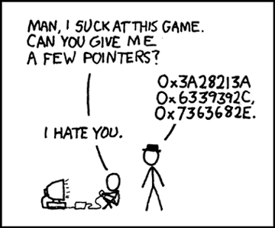
Pointers
One of the simplest ideas in C, but one which most students have a problem with is a pointer
Every variable is stored somewhere in memory
That address is an integer, so why can’t we store an address in a variable?
http://xkcd.com/138/

Slide 76
Pointers
We could simply have an ‘address’ type:
address ptr; // store an address
// THIS IS WRONG
however, the compiler does not know what it is an address of (is it the address of an int, a double, etc.)
Instead, we have to indicate what it is pointing to:
int *ptr; // a pointer to an integer
// the address of the integer variable 'ptr'

Slide 77
Pointers
First we must get the address of a variable
This is done with the & operator (ampersand/address of)
For example,
int m = 5; // m is an int storing 5
int *ptr; // a pointer to an int
ptr = &m; // assign to ptr the
// address of m

Slide 78
Pointers
We can even print the addresses:
int m = 5; // m is an int storing 5
int *ptr; // a pointer to an int
ptr = &m; // assign to ptr the
// address of m
cout << ptr << endl;
prints 0xffffd352, a 32-bit number
The computer uses 32-bit addresses

Slide 79
Pointers
We have pointers: we would now like to manipulate what is stored at that address
We can access/modify what is stored at that memory location by using the * operator (dereference)
int m = 5;
int *ptr;
ptr = &m;
cout << *ptr << endl; // prints 5

Slide 80
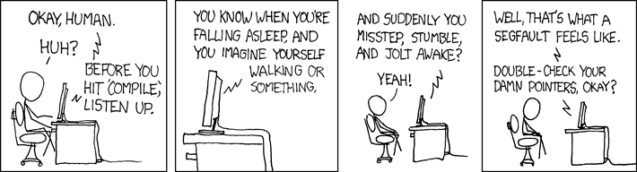
Pointers
Similarly, we can modify values stored at an address:
int m = 5;
int *ptr;
ptr = &m;
*ptr = 3; // store 3 at that memory location
cout << m << endl; // prints 3
http://xkcd.com/371/

Slide 81
Pointers
Pointers to objects must, similarly be dereferenced:
Complex z( 3, 4 );
Complex *pz;
pz = &z;
cout << z.abs() << endl;
cout << (*pz).abs() << endl;

Slide 82
Pointers
One short hand for this is to replace
(*pz).abs();
with
pz->abs();

Slide 83
Understanding C++: Memory Allocation

Slide 84
Memory Allocation
Memory allocation in C++ and C# is done through the new operator
This is an explicit request to the operating system for memory
This is a very expensive operation
The OS must:
Find the appropriate amount of memory,
Indicate that it has been allocated, and
Return the address of the first memory location

Slide 85
Memory Allocation
Memory deallocation differs, however:
C# uses automatic garbage collection
C++ requires the user to explicitly deallocate memory
Note however, that:
managed C++ has garbage collection
other tools are also available for C++ to perform automatic garbage collection

Slide 86
Memory Allocation
Inside a function, memory allocation of declared variables is dealt with by the compiler
int my_func() {
Complex<double> z(3, 4); // calls constructor with 3, 4
// creates 3 + 4j
// 16 bytes are allocated by the compiler
double r = z.abs(); // 8 bytes are allocated by the compiler
return 0; // The compiler reclaims the 24 bytes
}

Slide 87
Memory Allocation
Memory for a single instance of a class (one object) is allocated using the new operator, e.g.,
Complex<double> *pz = new Complex<double>( 3, 4 );
The new operator returns the address of the first byte of the memory allocated

Slide 88
Memory Allocation
We can even print the address to the screen
If we were to execute
cout << "The address pz is " << pz << endl;
we would see output like:
The address pz is 0x00ef3b40

Slide 89
Memory Allocation
Next, to deallocate the memory (once we’re finished with it) we must explicitly tell the operating system using the delete operator:
delete pz;

Slide 90
Memory Allocation
Consider a linked list where each node is allocated:
new Node<Type>( obj )
Such a call will be made each time a new element is added to the linked list
For each new, there must be a corresponding delete:
Each removal of an object requires a call to delete
If a non-empty list is itself being deleted, the destructor must call delete on all remaining nodes

Slide 91
Understanding C++: Classes

Slide 92
Classes
Why do we need classes and object-oriented programming?
Data encapsulation: clarity in terms of who gets to read/write data
Inheritance: code and data reuse
Polymorphism (virtual functions): cleaner and more intuitive code
Function and class templates: data structures and classes can be “templatized”
Resulting in better maintainability, more modular, efficient code, and thus more effective problem solving

Slide 93
Classes
To begin, we create a complex number class
To describe this class, we could use the following words:
Store the real and imaginary components
Allow the user to:
Create a complex number
Retrieve the real and imaginary parts
Find the absolute value and the exponential value
Normalize a non-zero complex number

Slide 94
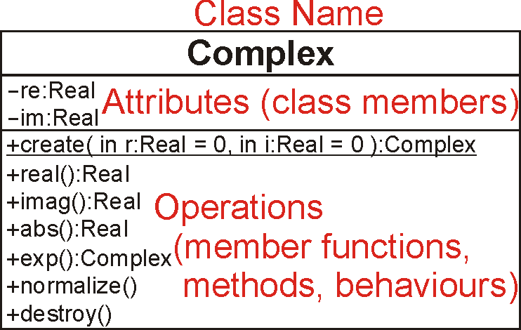
Understanding Classes
The three components include:
the name, the attributes, and the operations

Slide 95
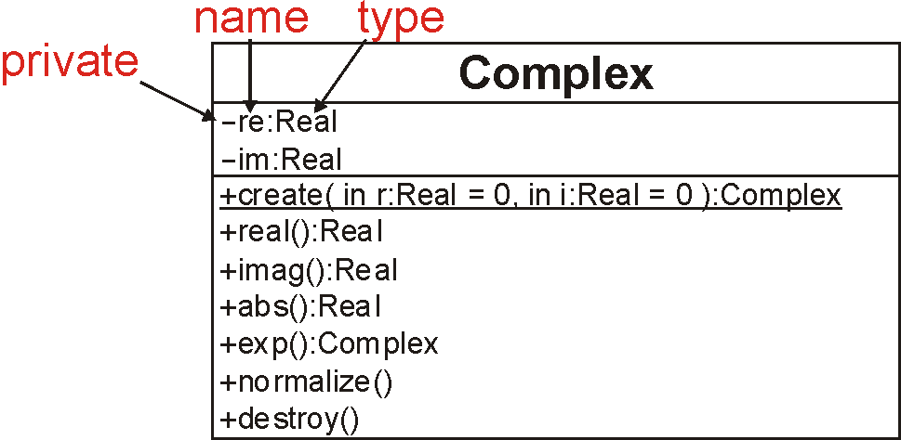
UML Class Diagrams
The attributes are described by:
a visibility modifier, a name, and a type

Slide 96
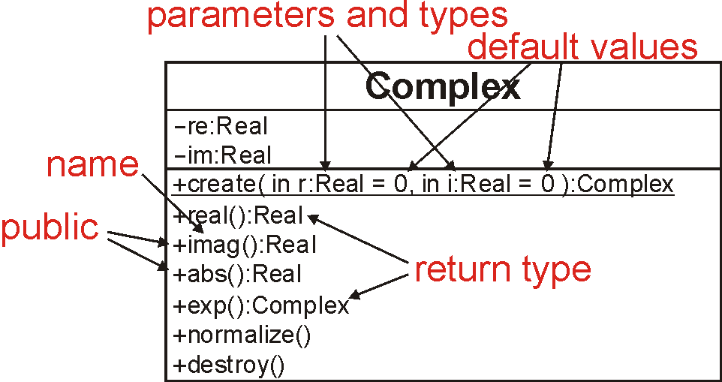
UML Class Diagrams
The operations (a.k.a. functions) include:
a visibility modifier, a name, parameters (possibly with default values) and return values

Slide 97
Classes
This only declares the class structure
It does not provide an implementation
We could, like C# or Java, include the implementation in the class declaration, however, this is not, for numerous reasons, standard practice

Slide 98
The Complex Class
The next slide gives both the declaration of the Complex class as well as the associated definitions
The assumption is that this is within a single file

Slide 99
The Complex Class
#ifndef _COMPLEX_H
#define _COMPLEX_H
#include <cmath>
class Complex {
private:
double re, im;
public:
Complex( double = 0.0, double = 0.0 );
// Accessors
double real() const;
double imag() const;
double abs() const;
Complex exp() const;
// Mutators
void normalize();
};

Slide 100
The Complex Class
Associates functions back to the class
// Constructor
Complex::Complex( double r, double i ):
re( r ),
im( i ) {
// empty constructor
}
Each member variable should be assigned
The order must be the same as the order in which the member variables are defined in the class
For built-in datatypes, this is a simple assignment.
For member variables that are objects, this is a call to a constructor.
For built-in datatypes, the above is equivalent to:
// Constructor
Complex::Complex( double r, double i ):re( 0 ), im( 0 ) {
re = r;
im = i;
}

Slide 101
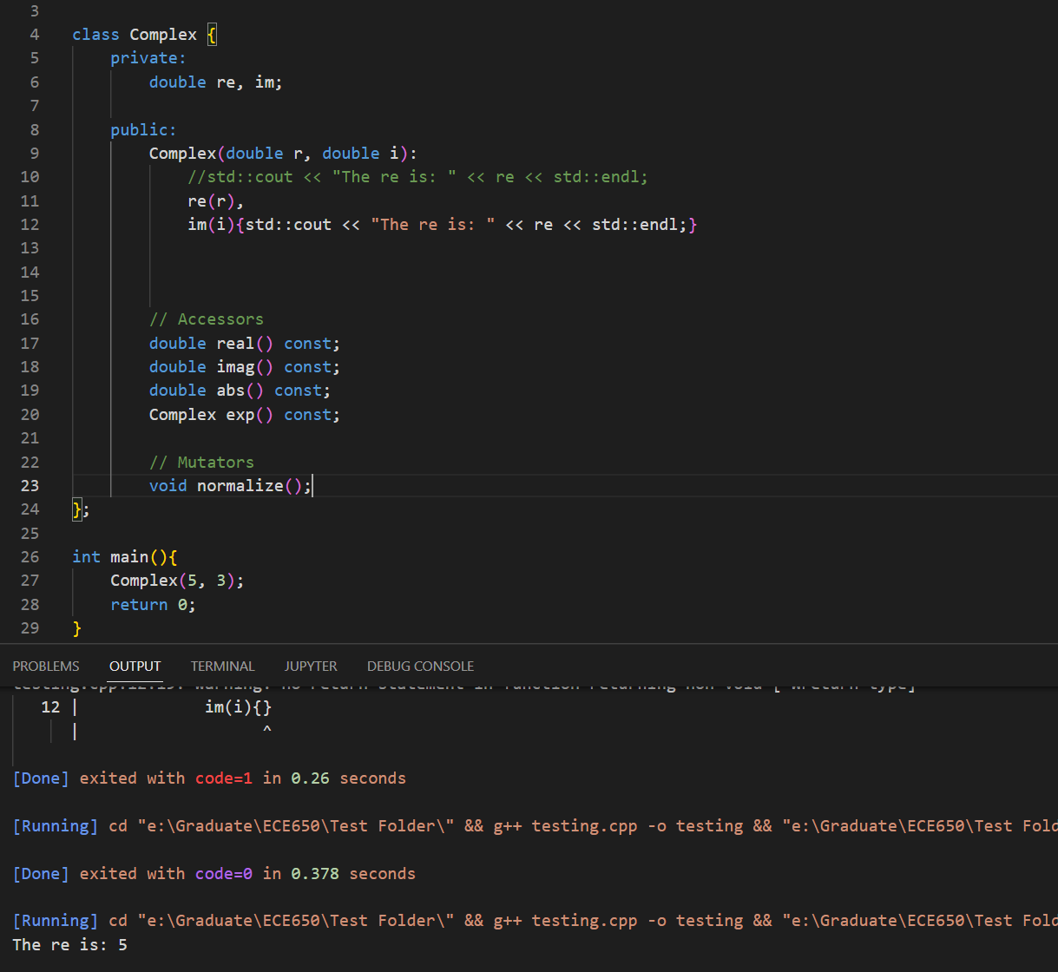

Slide 102
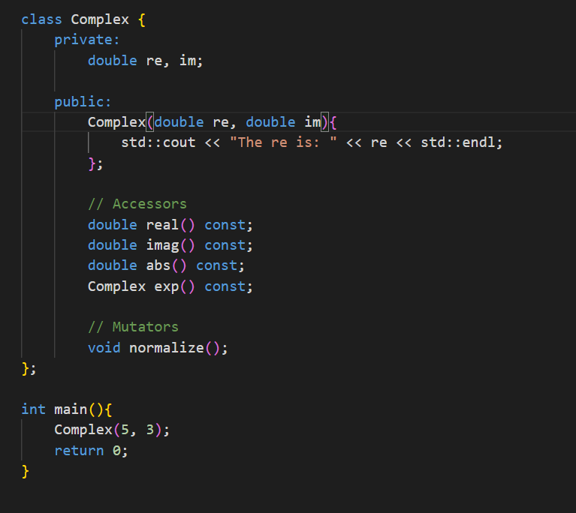

Slide 103
The Complex Class
// return the real component
double Complex::real() const {
return re;
}
// return the imaginary component
double Complex::imag() const {
return im;
}
// return the absolute value
double Complex::abs() const {
return std::sqrt( re*re + im*im );
}
Refers to the member variables re and im of this class

Slide 104
The Complex Class
// Return the exponential of the complex value
Complex Complex::exp() const {
double exp_re = std::exp( re );
return Complex( exp_re*std::cos(im), exp_re*std::sin(im) );
}

Slide 105
The Complex Class
// Normalize the complex number (giving it unit absolute value, |z| = 1)
void Complex::normalize() {
if ( re == 0 && im == 0 ) {
return;
}
double absval = abs();
re /= absval;
im /= absval;
}
#endif
This calls the member function double abs() const from the Complex class on the object on which
void normalize() was called

Slide 106
Visibility
Visibility in C# and Java is described by placing public/private/protected in front of each class member or member function
In C++, this is described by a block prefixed by one of
private:
protected:
public:

Slide 107
Visibility
class Complex {
private:
double re, im;
public:
Complex( double, double );
double real() const;
double imag() const;
double abs() const;
Complex exp() const;
void normalize();
};

Slide 108
Visibility
The reason for the change in Java/C# was that the C++ version has been noted to be a source of errors
Code could be cut-and-paste from one location to another, and a poorly placed paste could change the visibility of some code:
public → private automatically caught
private → public difficult to catch and dangerous

Slide 109
Visibility
It is possible for a class to indicate that another class is allowed to access its private members
If class ClassX declares class ClassY to be a friend, then class ClassY can access (and modify) the private members of ClassX

Slide 110
Visibility
class ClassY; // declare that ClassY is a class
class ClassX {
private:
int privy; // the variable privy is private
friend class ClassY; // ClassY is a "friend" of ClassX
};
class ClassY { // define ClassY
private:
ClassX value; // Y stores one instance of X
public:
void set_x() {
value.privy = 42; // a member function of ClassY can
} // access and modify the private
}; // member privy of "value"

Slide 111
Accessors and Mutators
We can classify member functions into two categories:
Those leaving the object unchanged
Those modifying the member variables of the object
Respectively, these are referred to as:
Accessors: we are accessing and using the class members
Mutators: we are changing—mutating—the class members

Slide 112
Accessors and Mutators
Good programming practice is to enforce that a routine specified to be an accessor (getter) cannot be accidentally changed to a mutator (setter)
This is done with the const keyword after the parameter list
double abs() const;

Slide 113
Accessors and Mutators
If a junior programmer were to try change
double Complex::abs() const {
return std::sqrt( re*re + im*im );
}
to
double Complex::abs() const {
re = 1.0; // modifying (mutating) 're'
return std::sqrt( re*re + im*im );
}
the compiler would signal an error

Slide 114
Understanding C++: Function and Class Templates

Slide 115
Templates
Now that we have seen an introduction to classes, the next generalization is templates
There are two kinds of templates
Function templates
Class templates
Suppose you have a data structure like a stack. What does a typical programmer expect from a stack?
API – to operate the stack
Create the stack (constructor)
Destroy the stack after use (destructor)
Push
Pop
Last-In First-Out (LIFO)
The principle behind templates is that they allow one to specialize functions and classes to specific types

Slide 116
Templates
Thus, it is possible to create an array which can hold instances of any class:
Object [] array = new Object[10];

Slide 117
Function Templates
Suppose you want to build a general linked list which could hold anything
In C#, you could have it store instance of the class Object
Because there is no ultimate Object class, to avoid re-implementing each class for each class we are interested in storing, we must have a different mechanism

Slide 118
Function Templates
This mechanism uses a tool called templates
A function has parameters which are of a specific type
A template is like a function, however, the parameters themselves are types

Slide 119
Function Templates
That mechanism is called a template:
template <typename Type>
Type sqr( Type x ) {
return x*x;
}
This creates a function which returns something of the same type as the argument

Slide 120
Function Templates
To tell the compiler what that type is, we must suffix the function:
int n = sqr<int>( 3 );
double x = sqr<double>( 3.141592653589793 );
Usually, the compiler can determine the appropriate template without it being explicitly stated

Slide 121
Function Templates
Example:
#include<iostream>
using namespace std;
template <typename Type>
Type sqr( Type x ) {
return x*x;
}
int main() {
cout << "3 squared is " << sqr<int>( 3 ) << endl;
cout << "Pi squared is " << sqr<double>( 3.141592653589793 ) << endl;
return 0;
}
Output:
3 squared is 9
Pi squared is 9.8696

Slide 122
Function Templates
Thus, calling sqr<int>( 3 ) is equivalent to calling a function defined as:
int sqr( int x ) {
return x*x;
}
The compiler replaces the symbol Type with int
template <typename Type>
Type sqr( Type x ) {
return x*x;
}

Slide 123
Class Templates
Our complex number class uses double-precision floating-point numbers
What if we don’t require the precision and want to save memory with floating-point numbers
Do we write the entire class twice?
How about templates?

Slide 124
Class Templates
#ifndef _COMPLEX_H
#define _COMPLEX_H
#include <cmath>
template <typename Type>
class Complex {
private:
Type re, im;
public:
Complex( Type const & = Type(), Type const & = Type() );
// Accessors
Type real() const;
Type imag() const;
Type abs() const;
Complex exp() const;
// Mutators
void normalize();
};

Slide 125
Class Templates
The modifier template <typename Type> applies only to the following statement, so each time we define a function, we must restate that Type is a templated symbol:
// Constructor
template <typename Type>
Complex<Type>::Complex( Type const &r, Type const &i ):re(r), im(i) {
// empty constructor
}

Slide 126
Class Templates
// return the real component
template <typename Type>
Type Complex<Type>::real() const {
return re;
}
// return the imaginary component
template <typename Type>
Type Complex<Type>::imag() const {
return im;
}
// return the absolute value
template <typename Type>
Type Complex<Type>::abs() const {
return std::sqrt( re*re + im*im );
}

Slide 127
Class Templates
// Return the exponential of the complex value
template <typename Type>
Complex<Type> Complex<Type>::exp() const {
Type exp_re = std::exp( re );
return Complex<Type>( exp_re*std::cos(im), exp_re*std::sin(im) );
}
// Normalize the complex number (giving it unit norm, |z| = 1)
template <typename Type>
void Complex<Type>:noramlize() {
if ( re == 0 && im == 0 ) {
return;
}
Type absval = abs();
re /= absval;
im /= absval;
}
#endif

Slide 128
Class Templates
Ouptut:
|z| = 5.5973207876626123181
|w| = 5.597320556640625
After normalization, |z| = 1.0000000412736744781
After normalization, |w| = 1
Example:
#include <iostream>
#include "Complex.h"
using namespace std;
int main() {
Complex<double> z( 3.7, 4.2 );
Complex<float> w( 3.7, 4.2 );
cout.precision( 20 ); // Print up to 20 digits
cout << "|z| = " << z.abs() << endl;
cout << "|w| = " << w.abs() << endl;
z.normalize();
w.normalize();
cout << "After normalization, |z| = " << z.abs() << endl;
cout << "After normalization, |w| = " << w.abs() << endl;
return 0;
}

Slide 129
Understanding C++: Operator overloading

Slide 130
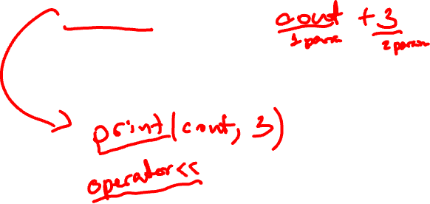
Printing
Printing in C++ is done through overloading the << operator:
cout << 3;
If the left-hand argument of << is an object of type ostream (output stream) and the right-hand argument is a double, int, string, etc., an appropriate function which prints the object is called

Slide 131
Printing
The format is suggestive of what is happening:
The objects are being sent to the cout (console output) object to be printed
cout << "The square of 3 is " << sqr(3) << endl;
The objects being printed are:
a string
an int
a platform-independent end-of-line identifier

Slide 132

Printing
How does
cout << "The square of 3 is " << sqr(3) << endl;
work?
This is equivalent to
((cout << "The square of 3 is ") << sqr(3)) << endl;
where << is an operation (like +) which prints the object and returns the cout object

Slide 133
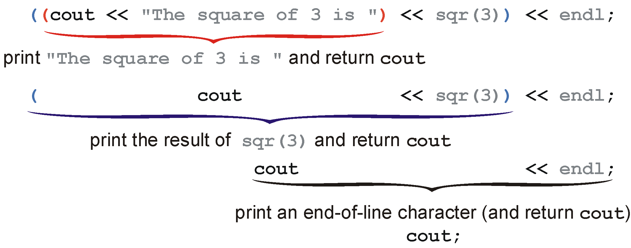
Printing
Visually:

Slide 134
Printing
Another way to look at this is that
cout << "The square of 3 is " << sqr(3) << endl;
is the same as:
operator<<( operator<<( operator<<( cout, "The square of 3 is " ), sqr(3) ), endl );
This is how C++ treats these anyway...

Slide 135
Next
Polymorphism and Inheritance

Slide 136
Usage Notes
These slides are made publicly available on the web for anyone to use
If you choose to use them, or a part thereof, for a course at another institution, I ask only three things:
that you inform me that you are using the slides,
that you acknowledge my work, and
that you alert me of any mistakes which I made or changes which you make, and allow me the option of incorporating such changes (with an acknowledgment) in my set of slides
Sincerely,
Douglas Wilhelm Harder, MMath
dwharder@alumni.uwaterloo.ca

